Slide 1
ADRENAL GLANDS
DR SWAAPNIKA

Slide 2
Adrenal Glands
•Paired organs
•Flattened structure with half – moon shape
•Surrounded by dense irregular connective tissue – reticular fibers for support
•Embedded in adipose tissue
•2 concentric layers:
–Adrenal cortex
–Adrenal medulla

Slide 3
•Cells of both layers are grouped in cords along capillaries
•Dense CT capsule sends thin septa to the interior of the gland – trabeculae

Slide 4
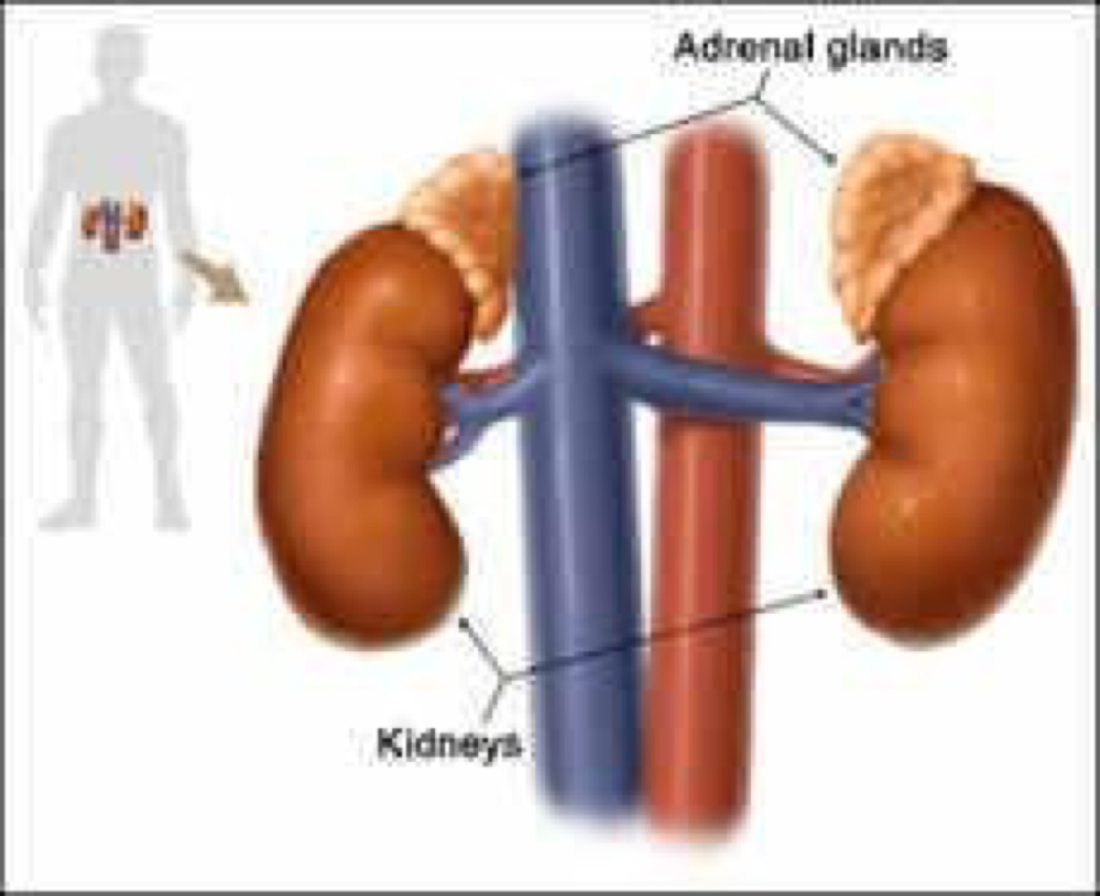
Location
Lie near the superior poles of
kidneys

Slide 5
Capsule
Cortex
Medulla

Slide 7
Adrenal cortex
•Cells contain numerous lipid droplets
•Spongyocytes
•Cells that secrete glucocorticoids, mineralocorticoids, and gonadocorticoids
•Has 3 concentric layers with fenestrated capillaries

Slide 8
3 Concentric Layers
•Zona glomerulosa
ØOccupy 15% of the cortex
ØImmediately beneath the capsule
ØColumnar or pyramidal cells
ØArranged in closely packed, rounded, arched cords, or small clumps

Slide 9
RED – Cells of zona glomerulosa
BLUE – sinusoidal capillaries and endothelial cells

Slide 10
3 Concentric layers
•Zona Fasciculata
ØOccupy 65% of the cortex
ØIntermediate zone
ØPolyhedral, often binucleated cells with lipid
droplets in their cytoplasm
ØCells are also called spongyocytes due to
vacuolization
ØArranged in one or two – cell thick straight cords

Slide 11
RED – Cells of zona fasciculata
BLUE – sinusoidal capillaries

Slide 12
3 Concentric Layers
•Zona Reticularis
Øoccupy 7% of the cortex
ØInnermost layer – lies between zona fasciculata and medulla
ØSmaller cells disposed in irregular cords forming an anastomosing network
ØPresence of lipofuscin pigment granules – large and numerous
ØIrregularly shaped cells with pyknotic nuclei –
suggesting cell death
ØArranged in cords or clumps

Slide 13
RED – Cells of zona reticularis
BLUE – Pigmented cells

Slide 15
Hormones
•Mineralocorticoids
•Glucocorticoids
•Androgens

Slide 16
Mineralocorticoids
•Secreted from adrenal cortex – zona glomerulosa
•Steroid hormones – aldosterone
•Important for electrolyte homeostasis and water balance
•Act mainly on the distal kidney tubules, salivary glands, and sweat glands
•Stimulates reabsorption of sodium and increase potassium excretion into urine

Slide 18
Glucocorticoids
•Secreted from adrenal cortex – zona fasciculata
•Include the principal hormone - cortisol
•Affect the metabolism of carbohydrates, proteins, and lipids
ØStimulation of gluneogenesis
ØMobilization of amino acids from extrahepatic tissues
ØInhibition of glucose uptake in muscle and adipose tissues
ØStimulation of fat breakdown

Slide 19
Glucocorticoids
•Suppress immune response
ØDestroying circulating lymphocytes
ØInhibiting mitotic activity
ØControlling secretion of cytokines
•Promotes maturation of lung and production of surfactant in fetal development

Slide 20
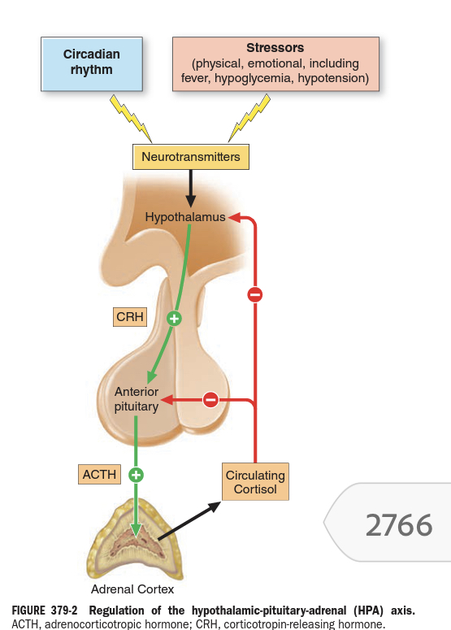

Slide 21
Androgen
•Secreted from the adrenal cortex - zona reticularis
•Males: male sexual characteristics
•Females: female sex drive
•Dehydroepiandosterone
ØWeak androgen
ØCirculates the blood as a sulfate
ØExerts it actions after being converted to testosterone

Slide 22
Medulla
•Lies in the center of the adrenal gland
•Composed of polyhedral cells
•Arranged in cords or clumps, supported by reticular fiber network
•Composed of chromaffin cells
•Secretes catecholamines
•Contains sympathetic ganglion cells

Slide 23
Chromaffin cells
•A neuroendocrine cell
•Release neurotransmitter into systemic circulation for systemic effects on multiple organs
•Contains N and E cells
ØSecretes Norepinephrine and Epinephrine
respectively

Slide 24
E Cells
•Characterized by containing small granules
•Store epinephrine

Slide 25
NE Cells
•Characterized by larger granules
ØContains dense cores giving an appearance of eccentric “bulls - eyes”
•More intense chromaffin reaction
•Store norepinephrine

Slide 26
Hormones ( Medulla)
•Catecholamines
ØEpinepherine
ØNorepinephrine

Slide 27
Epinephrine
•Prepares the body for “fright, fight, or flight”
•Increased heart action
•Vasoconstriction in most systemic arteries and veins
•Rate and depth of breathing increases
•Force of muscular contraction is increased

Slide 28
NorEpinephrine
•Increases blood pressure
•Stimulates respiration and gastrointestinal contractions
•Triggering release of glucose
•Suppress neuroinflammation
•Increases blood pressure by increasing tension of muscles

Slide 29
